Slide 1



Pharmaceutical Knowledge

Slide 2
Medication Types

Slide 3
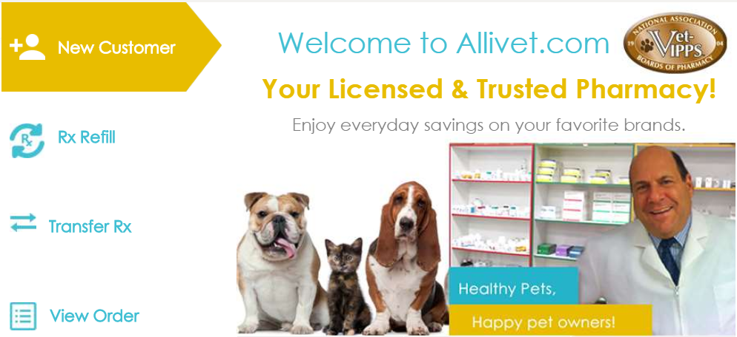
Medication Types
Allivet carries a variety of pharmaceutical items. These range from over the counter supplements, oral antibiotics, heart medication and injectable solutions.
Notes:
Full Scope of Medication
Allergy & Antihistamines
Antibiotics
Anti-Cancer & Tumor
Anti-Fungal
Anxiety & Behavior
Arthritis Pain & Anti-Inflamatory
Asthma & Respiratory
Colic & Musculoskeletal
Cushing’s Disease
Diabetes & Insulin
Diagnostic Devices
Digestive Track, Liver, & Pancreas
Ear Medication
Epilepsy & Seizure
Estrus & Luteolytic
Eye Medication
Heart & Blood Pressure
Heartworm Preventatives
Immune System
Injectable Vitamins & Electrolytes
Parasite Internal & External
Sedatives
Skin Irritation
Syringes & Needles
Thyroid & Hormone
Urinary Tract & Kidney
Wound Care

Slide 4
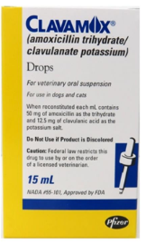
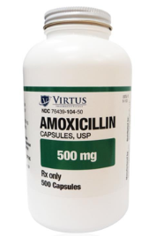
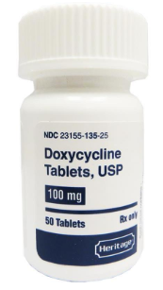
Medication Types
Antibiotics
Antibiotic: A drug used to treat bacterial infections only. They have no effect on viral infections. An antibiotic is a substance produced by one microorganism that selectively inhibits the growth of another.
Allivet carries a variety of antibiotics
Many of these medications are human grade
They are the same medication you would find at your local pharmacy should your doctor prescribe them.
Just because we sell human grade medication does NOT mean that we sell for HUMAN USE!

Slide 5
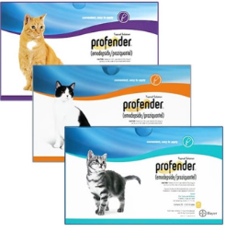
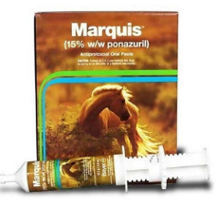
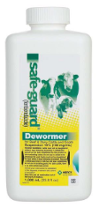
Medication Types
De-Wormers
Deworming (sometimes known as worming, drenching or "dehelmintization") is the giving of an anthelmintic drug (a wormer, dewormer, or drench) to an animal to rid them of helminths parasites, such as roundworm, flukes and tapeworm.
Allivet carries an assortment of brands and types of dewormers for a variety of different species.
Dewormers are offered in different forms:
Tablets
Suspensions
Pastes

Slide 6
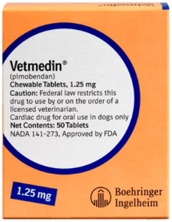
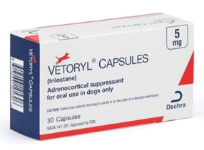
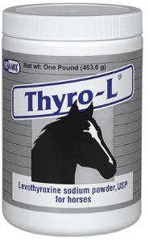
Medication Types
Specified Issues
Allivet carries medication that covers specific issues such as:
Heart Failure
Thyroid Disease
Cushing’s Disease
Diabetes
Epilepsy

Slide 7
Medication Types
Delivery Form

Slide 8

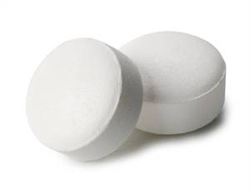
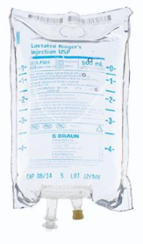
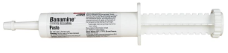
Medication Types
Delivery Form
Medication can come in many different forms. Allivet will only ship you the form prescribed by your vet.
Allivet can carry the same medication in different forms such as:
Tablets
Capsules
Suspensions
Injections
Aerosols
Paste

Slide 9
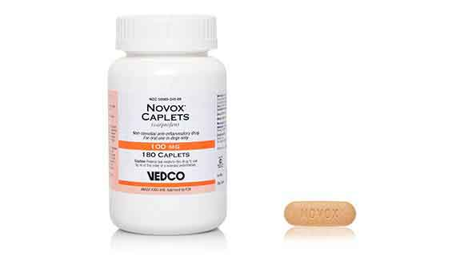
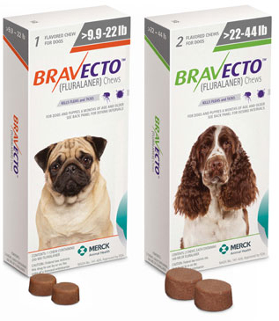
Medication Types
Delivery Form
Tablets
Tablet: A small disk or cylinder of a compressed solid substance, typically a measured amount of a medicine.
Allivet carries two additional forms of tablets:
Caplet: These are smaller tablets with a smooth outer coating making them easier to swallow.
Chewable Tablet: Available in a variety of flavors and come in two forms:
A chalky dissolvable tablet
A chewy gelatin form
Notes:
TRANSITIONS
Transition 1= After reading the tablet definition
Transition 2= After reading the definition of a caplet
Transition 3= After reading the definition of a chewable tablet

Slide 10
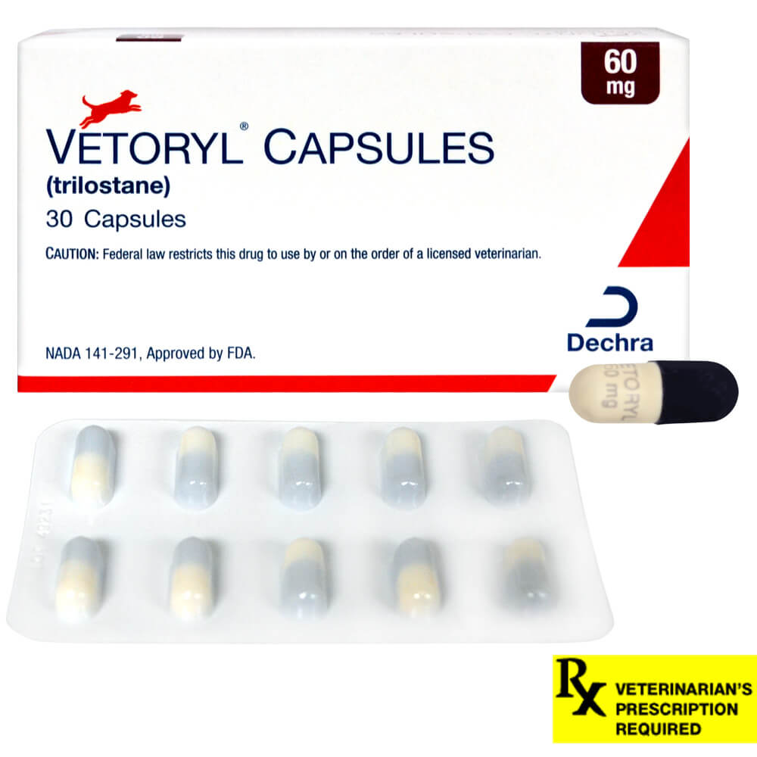
Medication Types
Delivery Form
Capsules
Capsule: A water soluble shell which is filled with the medication.
Easy to swallow and usually allow for fast release of the medication
Notes:
TRANSITIONS
Transition 1= After reading the tablet definition
Transition 2= After reading the definition of a caplet
Transition 3= After reading the definition of a chewable tablet

Slide 11
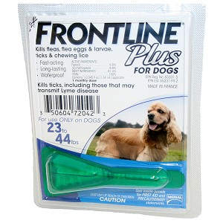
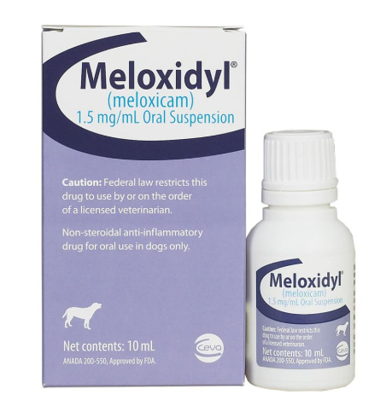
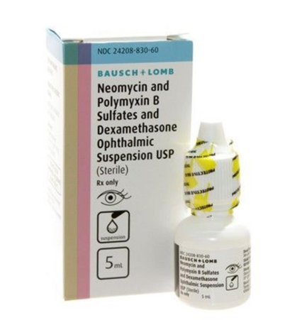
Medication Types
Delivery Form
Suspensions
Suspension: A way to deliver solid medications in liquid form.
Allivet carries each of the different forms of suspension:
Topical Suspensions
Oral Suspensions
Ophthalmic Suspensions
Notes:
TRANSITIONS
Transition 1= After reading Topical suspensions
Transition 2= After reading Oral suspensions
Transition 3= After reading Ophthalmic Suspensions

Slide 12
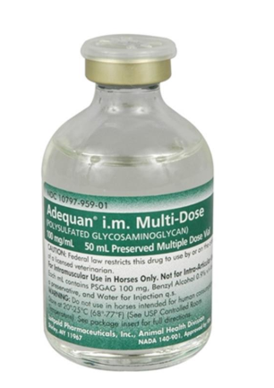
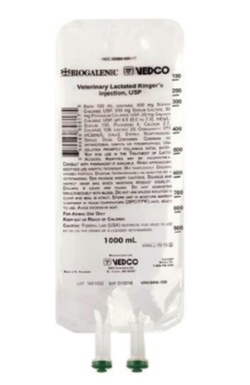
Medication Types
Delivery Form
Injectables
Injectables: Liquid medication put into the animal's body using a needle.
Allivet carries both injectables and IV solutions.
Some solutions, and injectables are meant to be given subcutaneously (under the skin), or intramuscularly (in the muscle).

Slide 13
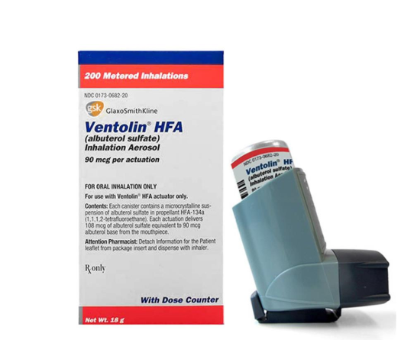
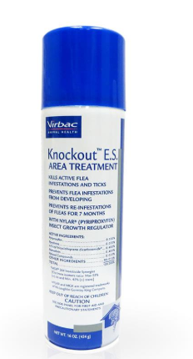
Medication Types
Delivery Form
Aerosols
Aerosols: a substance enclosed under pressure and able to be released as a fine spray, typically by means of a propellant gas.
All aerosols must be shipped via Fedex Ground
Federal law does not allow pressurized gas canisters to be transported in airplanes.

Slide 14
Identifying Medications

Slide 15

Identifying Medications
Helping a Customer
Typically, customers already know which medication they are looking to purchase. Occasionally though, customers will need guidance.
How to identify which medication is needed?
Verify what kind of pet this is for
Guide them through the website using the information given to you
Advise them they should be able to locate the most suitable medication for their pet here.
Always advise them to contact their veterinarian to confirm that this would be a suitable medication for their pet
Notes:
Transitions per point.
Additional Information
Should clients call regarding a medication they have received and would like to receive again confirm with the pharmacy that we have instock
You will need to get a description of what the client has received before contacting the pharmacy
Color
Shape
Type of medication (tablet, capsule, ect.)

Slide 16
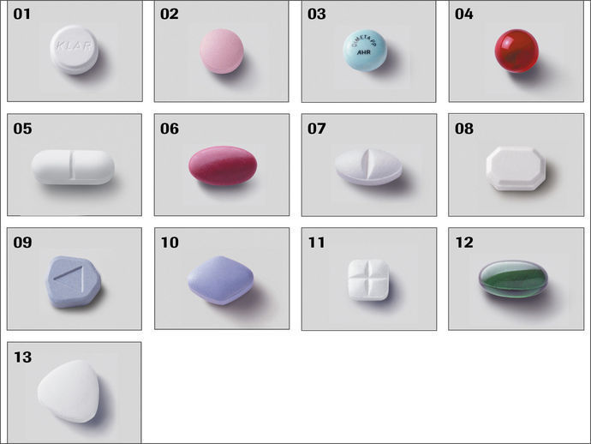

Identifying Medications
Helping a Customer
Medications come in different shapes, colors, and sizes. These can even vary for the same medication depending on who manufactures it.
Example:
Tablets can vary in shape:
Round
Square
Oval
Triangle
Capsules can vary in color
Notes:
Generic drugs are manufactured by different companies

Slide 17
Cold shipping vs Cold Storage

Slide 18

Cold shipping vs cold storage
Many of our liquid items will need to either be shipped with non-sweat cold packs, or, stored within the refrigerator once they are opened due to being exposed to different bacteria or being oxygenized.
Cold Shipping
Items that are marked online with a blue thermometer are items that NEED to be shipped cold.
These are items that are stored 24/7 in a refrigerator and will not be viable should they be kept out of the cold for long periods of time.
Cold Storage
Items which are not marked with this a blue thermometer are safe to be shipped without the additional cold shipping precautions.
Many of these items will indicate how you should store them within the “Product Overview” table.

Slide 19
Basic Pharmacy Regulations

Slide 20

Basic Pharmacy Regulation
What is a RX?
Rx: Denotes a medical prescription. The symbol "Rx" is usually said to stand for the Latin word "recipe" meaning "to take." It is customarily part of the superscription (heading) of a prescription.
Prescriptions are REQUIRED for many of Allivet’s medications.
Orders with Rx medications without having a valid prescription on file will NOT be shipped out.
This is the official way for a veterinarian to provide a pharmacy, and their customer instructions on what medications to dispense, how and how often they should be administered.

Slide 21
Basic Pharmacy Regulation
What is acceptable?
Clients will need to have their veterinary’s authorization prior to any shipment of a prescription item. However not all forms of authorization are acceptable.
Acceptable | Not Acceptable
Veterinarian verbal authorization | Client verbally advising this was approved by the vet.
Veterinarian faxing the prescription | Client faxing the prescription
Veterinarian emailing the prescription | Client emailing the prescription
Client mailing the ORIGINAL prescription | Client mailing a copy of the prescription
International prescriptions from the client or the veterinarian | International prescriptions NOT written in English

Slide 22
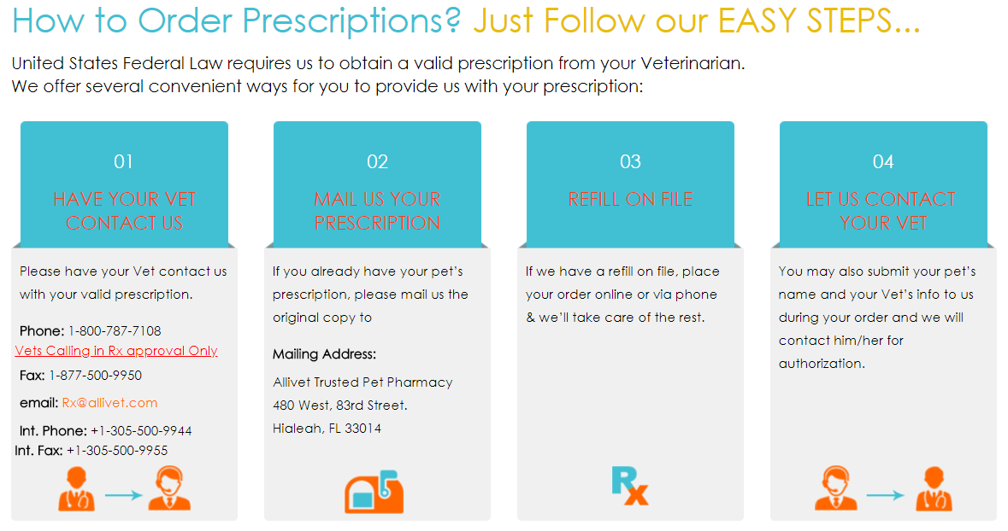
Basic Pharmacy Regulation
How to get a RX to us?

Slide 23

Basic Pharmacy Regulation
Under NO circumstance do we:
Give any form of medical advice to a customer.
Make any suggestions or recommendations of products to customers.
Speak to customers regarding what dosing their veterinarian has authorized for their pet.
Notes:
Transitions per point.

Slide 24
Common Medications

Slide 25

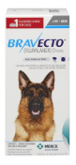
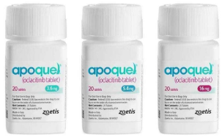
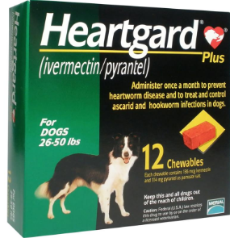

Common Medications
Top 10
Vetmedin
Heart Failure Medication
Apoquel
Allergy Medication
Bravecto
Flea and Tick Medication
Heartgard Plus
Heartworm Preventative
Vetoryl
Cushing’s Medication
Notes:
TRANSITIONS
Each number has a transition

Slide 26
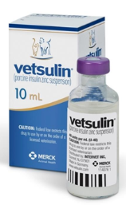
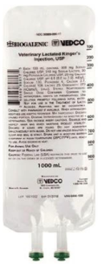
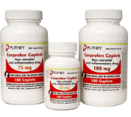
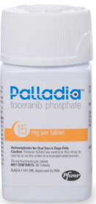
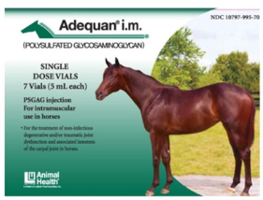
Common Medications
Top 10 Cont.
Carprofen
Pain/Anti-Inflamatory
Vetsulin
Diabetes
Adequan
Joint/Arthritis Medication
Palladia
Chemo Treatment
Lactated Ringers
Electrolytes
Notes:
TRANSITIONS
Each number has a transition

Slide 27
Controlled Substances

Slide 28
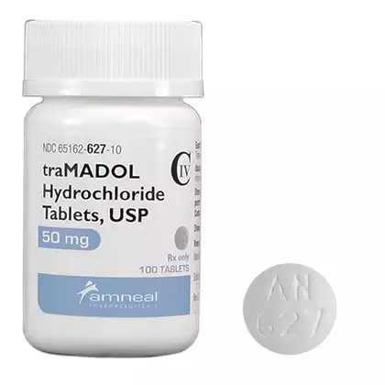
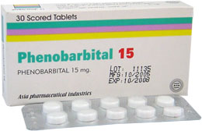
Controlled Substances
Allivet is not federally licensed to dispense controlled substances.
Some of these controlled substances are powerful pain medications (narcotics), Barbiturates, and powerful psychotropics
Some of the commonly requested controlled substances are:
Tramadol
Pain Medication
Phenobarbital
Used for Seizures

Slide 29
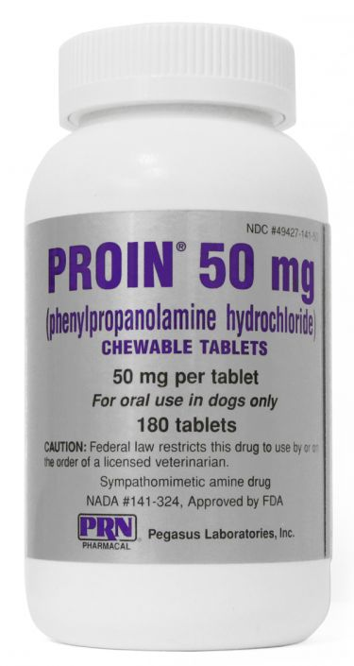
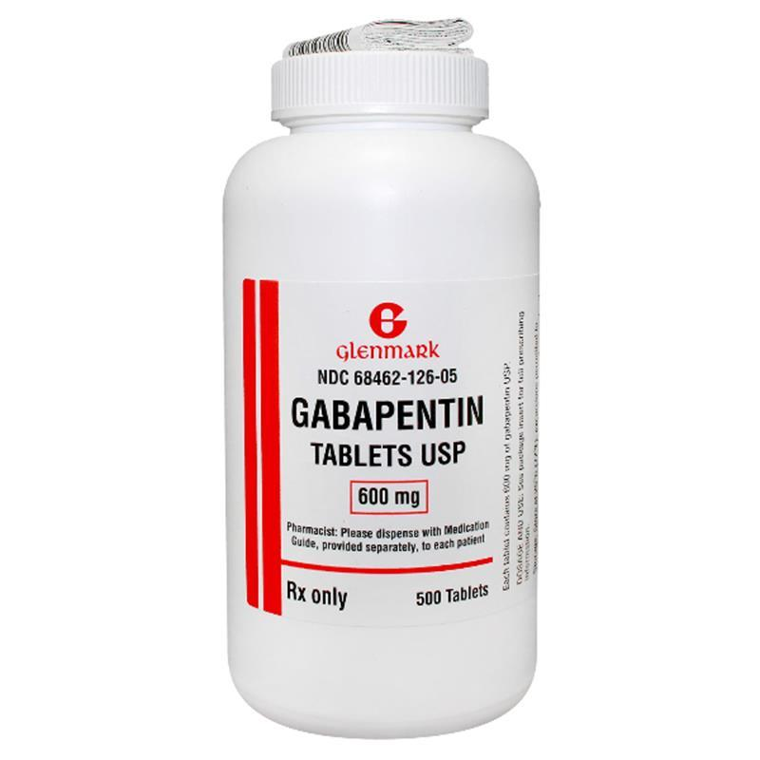

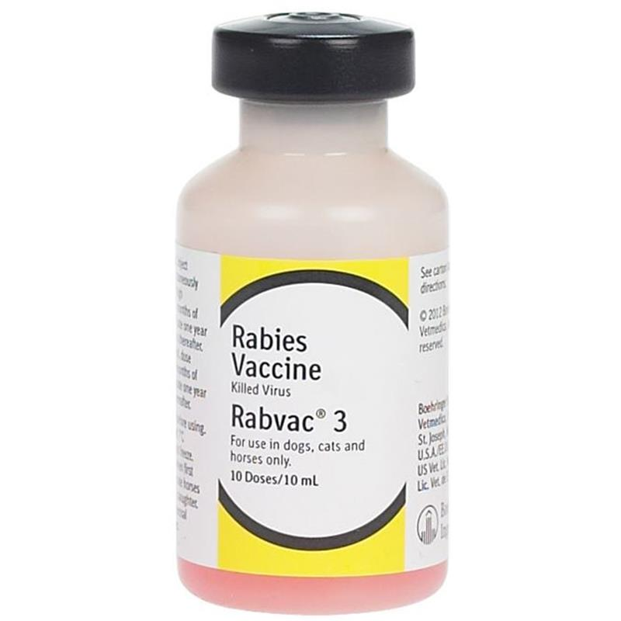
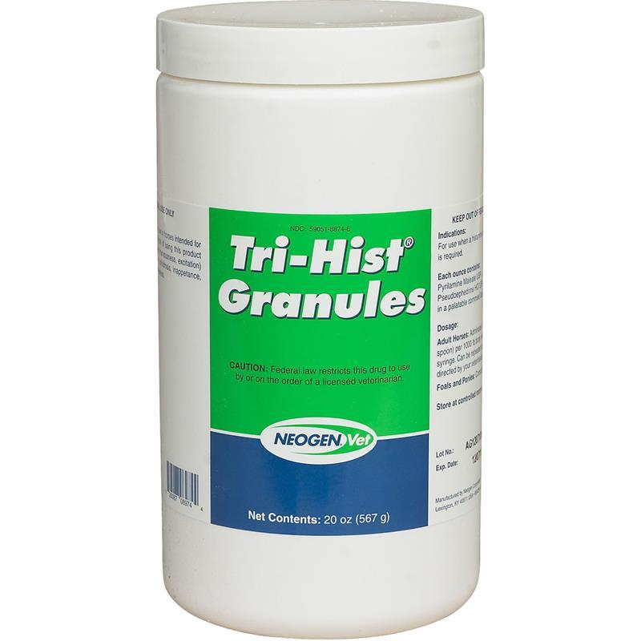
Controlled Substances
Some items Allivet carries are considered controlled substances within some, but not all states
We will not ship controlled substances to those states
Proin: Incontinence issues
Gabapentin: Pain and anti-seizure
Rabies Vaccines (Rabvac-3): Rabies
Tri-hist: Antihistamine and decongestant

Slide 30
Exceptions

Slide 31
Exceptions
International
We do not ship prescriptions internationally, only OTC items

